Slide 1
Heart Diseases Analysis
Pranali Dattaram Tatkare

Slide 2
Project Title - Analyzing Amazon Sales data
Technologies - Data Science
Domain - E-commerce

Slide 3
Problem Statement:
Sales management has gained importance to meet increasing competition and the need
for improved methods of distribution to reduce cost and to increase profits. Sales
management today is the most important function in a commercial and business
enterprise.
Do ETL: Extract-Transform-Load some Amazon dataset and find for me
Sales-trend -> month-wise, year-wise, yearly_month-wise
Find key metrics and factors and show the meaningful relationships between
attributes.

Slide 4
Python File-
:Heart Diseases Analysis

Slide 5
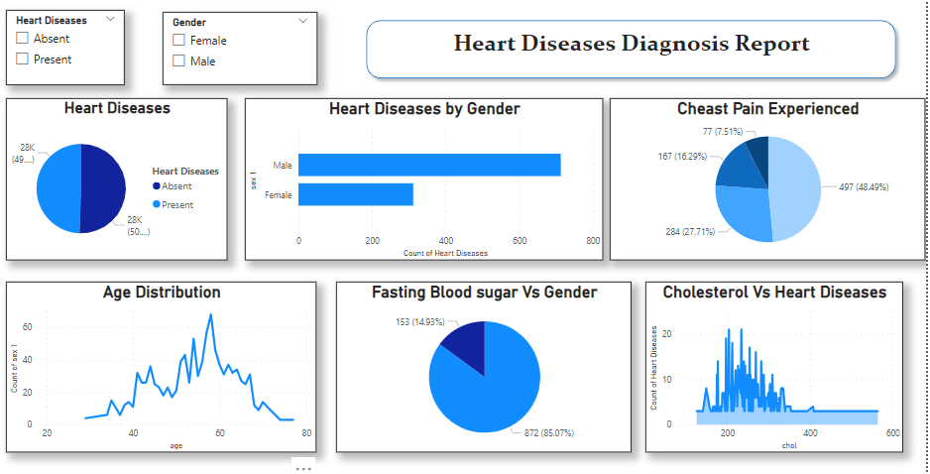

Slide 6
Thank You

